Slide 1
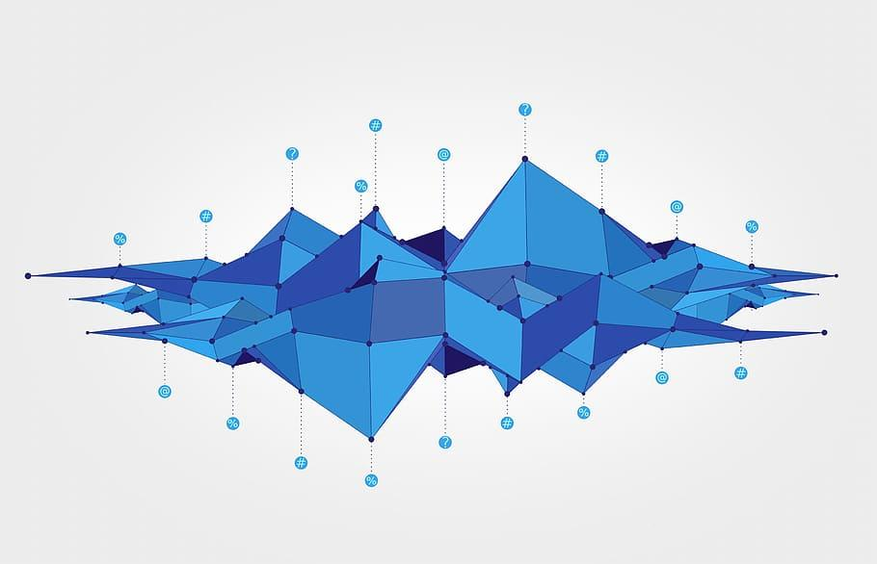
TEAM 8
Gabriel Pila
Viggy Palaniappan
Yulin Wang

Slide 2






Introduction
Context: Imagine we are a venture capital firm and have a large sum of money to invest somewhere…
We need to build an application that can help us decide what technology to invest money in and what resources to hire for it.
(Alternative Context): Imagine we are leaking money
We need to build an application that can help us decide what technology to stay invested in and what resources to keep.

Slide 3




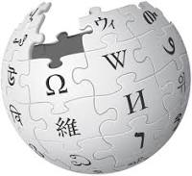
Data Sources & Methodology
We made use of 5 data sources:
(Graph data)
Neo4J technologies data (provided)
(Graph data)
ACM Digital Library
(Relational data)
Postgres patents and awards (provided)
(Relational data)
Papers from UCSD Dimensions Data Nexus Portal
(Semi Structured data)
Wikipedia API
Role, Contents
List of technologies, and companies that have expertise in them.
A computing classification system which has keywords organized by field within computing
List of patents and grant awards including source of awards, dates, citations, status.
2022 paper publications from universities (decided to select publications from each of our undergrad universities)
Wiki page html, page content, infobox

Slide 4



Application WorkFlow to build a decision helper report on what technology to invest money and what resources to hire for it.
1. Pre-select Top 50 technologies
From the patents’ neo4j dataset select X technologies to explore
5. Find the paths that relate the keywords from the tech to the documents
Using the keywords as intermediate nodes, find which docs are connected and return the most important
Tec1
Highest awards
Highest co-authorings
Tech: Machine Learning, Quantum computing
Kw1
Highest citations
Tech 1 → patent_id1, patent_id2, paper_id1, paper_id2, award_id1, award_id2
2. Define a set of keywords related to the technologies
Extract keywords from ACM Library for each technology.
Keyword_universe: [
‘quantum computing‘,
‘efficient computing’,
‘natural language processing’,
‘explainability’,
‘computer vision’
]
6. Get information about the selected document ids
From the chosen ids, get interesting data from the available datasets on postgres.
Select
(important_data)
From patentsdb
Where id in (patent_id1, patent_id2)
Select
(important_data)
From awardsdb
Where id in (award_id1, award_id2)
Select (important_data)
From papersdb
Where id in (paper_id1. paper_id2)
Co-occurrence graph connected by keywords
Note: If we include more keywords, our co-occurrence graph will be denser
Tec1
Tec2
Tec3
Kw1
Kw2
3. Detect keywords in from texts of relational datasets
Look for the existence of a list of keywords in the texts of the papers, awards, and patents datasets and add the found keywords as a new column
7. Get wikipedia documents from the selected ids
Look for summary or sidebar information about the companies, universities, technologies etc.
patent_id1 → ‘General motors’ (webpage)
Paper_id2 → ‘UC San Diego’ (webpage)
Kw3
Companies
Patentsdb → [‘explainability’, ‘quant computing]
Awardsdb → [‘nlp’, efficient computing‘]
Papersdb → [‘computer vision’, ‘nlp’’]
awards
papers
patents
Universities
Topics
4. Load the ids, keywords and attributes to neo4j
Extract the ids, keywords and attributes from postgres and load them to neo4j (nodes and edges)
8. Build a report with the gathered data
Use information retrieved from 6 and 7 to build a report around a technology of interest.
Topic data
Money in the game
Competitors
Tec1
Legal implications
Patentsdb → [‘explainability’, ‘quant computing]
Awardsdb → [‘nlp’, efficient computing‘]
Papersdb → [‘computer vision’, ‘nlp’’]
Hiring prospects
Overall evaluation

Slide 5
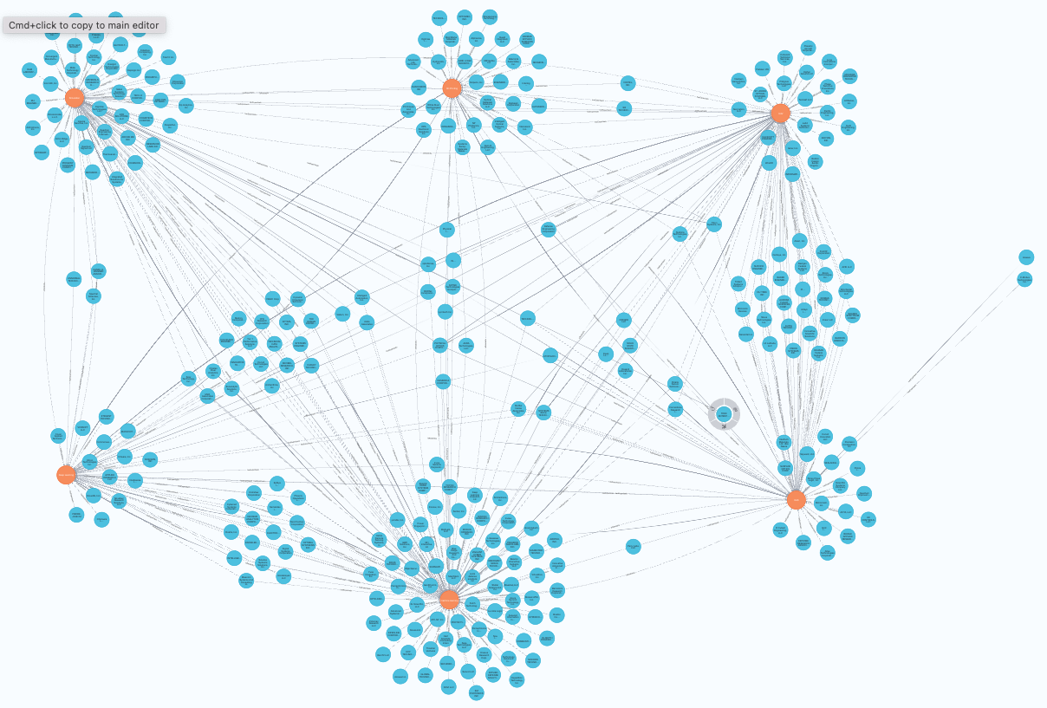
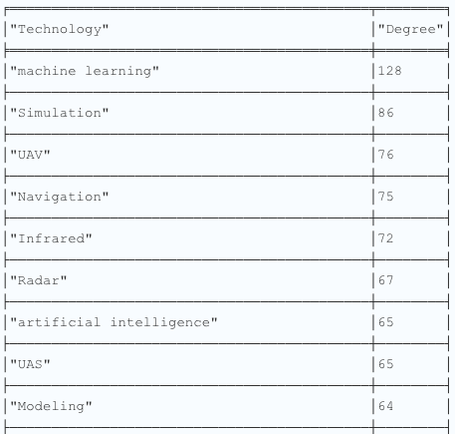
Selecting technologies from neo4j
1. Pre-select Top 50 technologies
From the patents’ neo4j dataset select X technologies to explore
Tech: Machine Learning, Quantum computing
Visualize the data (from given neo4j database)
From python, query the technologies and filter Top 50
match p= (a:technology)-[r:hasExpertiseIn]-(b)
return p
limit 500
match p= (a:technology)-[r:hasExpertiseIn]-(b)
return a.name AS Technology, count(p) AS Degree
order by Degree desc
UAV
UAS
Deep learning
ML technology & companies with expertise in it

Slide 6
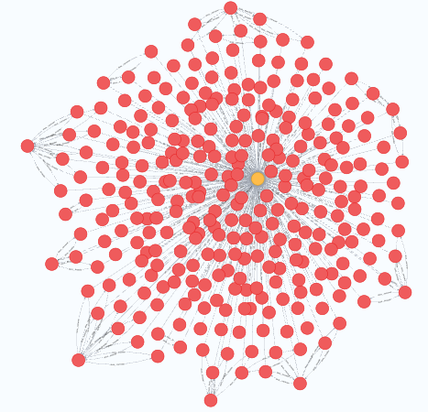
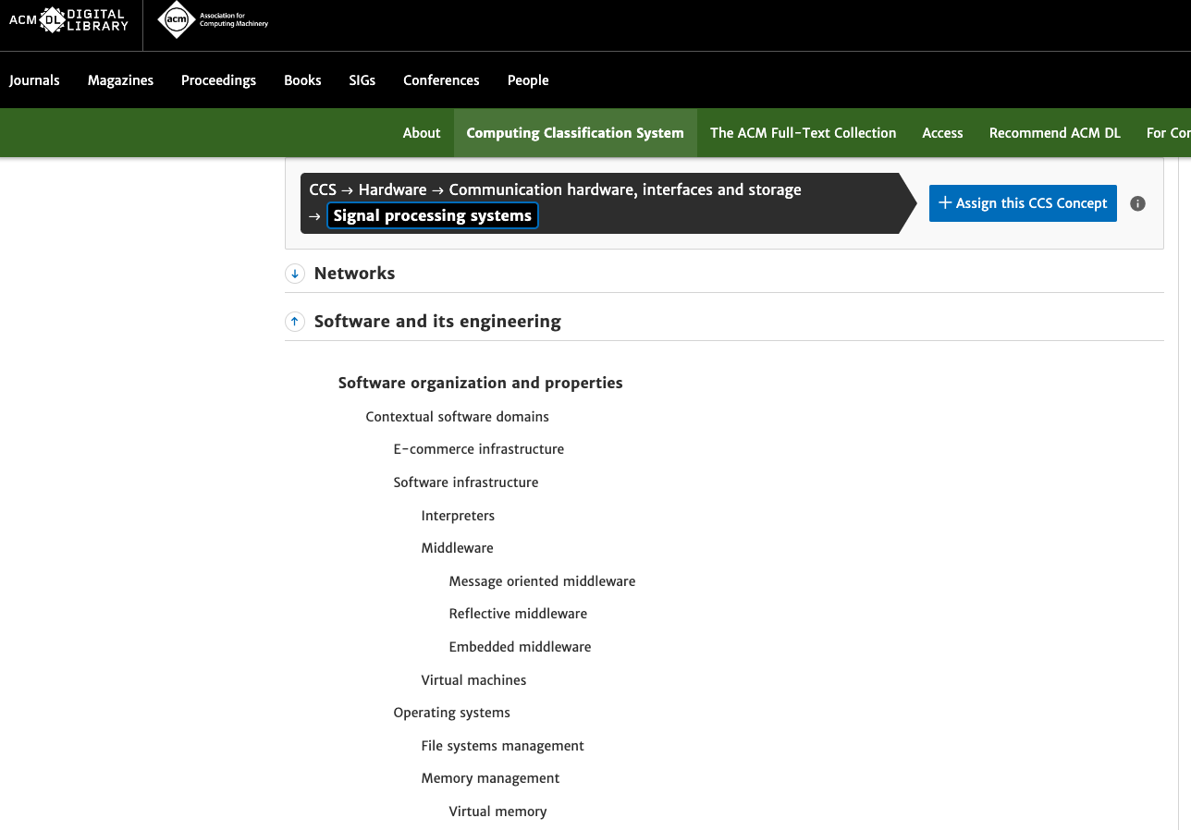
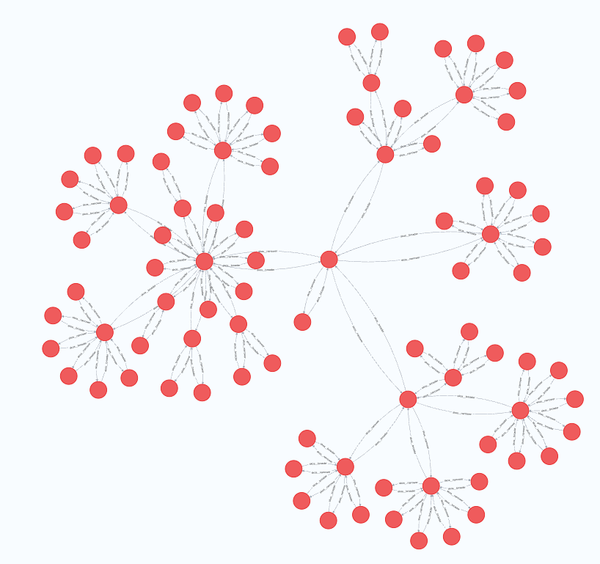
Create a keyword universe for each technology
2. Define a set of keywords related to the technologies
Extract keywords from ACM Library for each technology.
Keyword_universe: [
‘quantum computing‘,
‘efficient computing’,
‘natural language processing’,
‘explainability’,
‘computer vision’
]
Note: If we include more keywords, our co-occurrence graph will be denser
RDF upload into neo4j
Querying for ‘Machine Learning’
The ACM digital library has an ontology we can use to pick out keywords for areas within computing.
This ontology was available in rdf format (written in xml). Using this .rdf file, we generated a graph version of the ACM tree from which we could pick out keywords for each domain/technology

Slide 7
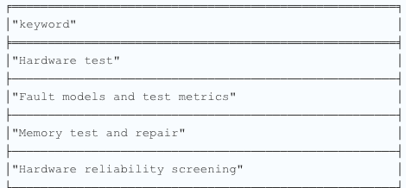
Create a keyword universe for each technology
2. Define a set of keywords related to the technologies
Extract keywords from ACM Library for each technology.
Keyword_universe: [
‘quantum computing‘,
‘efficient computing’,
‘natural language processing’,
‘explainability’,
‘computer vision’
]
Note: If we include more keywords, our co-occurrence graph will be denser
Querying for ‘Machine Learning’
using variable range relationship patterns
6-tier ontology means we search 6 levels deep
MATCH p=(j:skos__Concept {skos__prefLabel:'Machine learning' })-[r:skos__narrower*..6]->(b)
RETURN p
But we are interested in the keywords, not the path. This query flattens out the graph and gives all keywords under ‘hardware’
Querying for ‘Machine Learning’
MATCH p=(j:skos__Concept)-[r:skos__narrower*..6]->(b)
WHERE j.skos__prefLabel =~ '(?i)HARDWARE'
RETURN b.skos__prefLabel AS keyword
Used regexp with case insensitivity

Slide 8
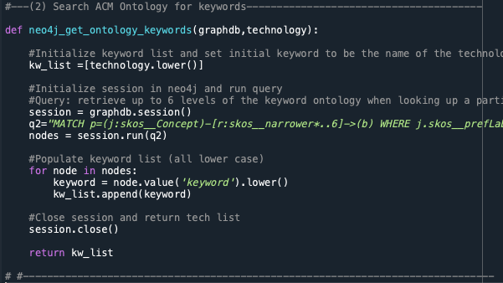
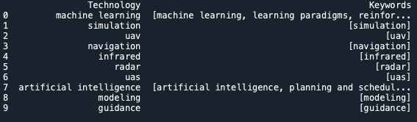
Create a keyword universe for each technology
2. Define a set of keywords related to the technologies
Extract keywords from ACM Library for each technology.
Keyword_universe: [
‘quantum computing‘,
‘efficient computing’,
‘natural language processing’,
‘explainability’,
‘computer vision’
]
Note: If we include more keywords, our co-occurrence graph will be denser
Keyword Universe
E.g. this function in python to pick up keywords was called for every technology (~29,000) in the original neo4j dataset to find related ACM ontology keywords.
Where there were no matches, the technology itself was passed on as a keyword. Since we had a computing ontology, these are the ones that are ‘useful’

Slide 9
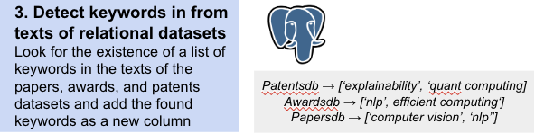
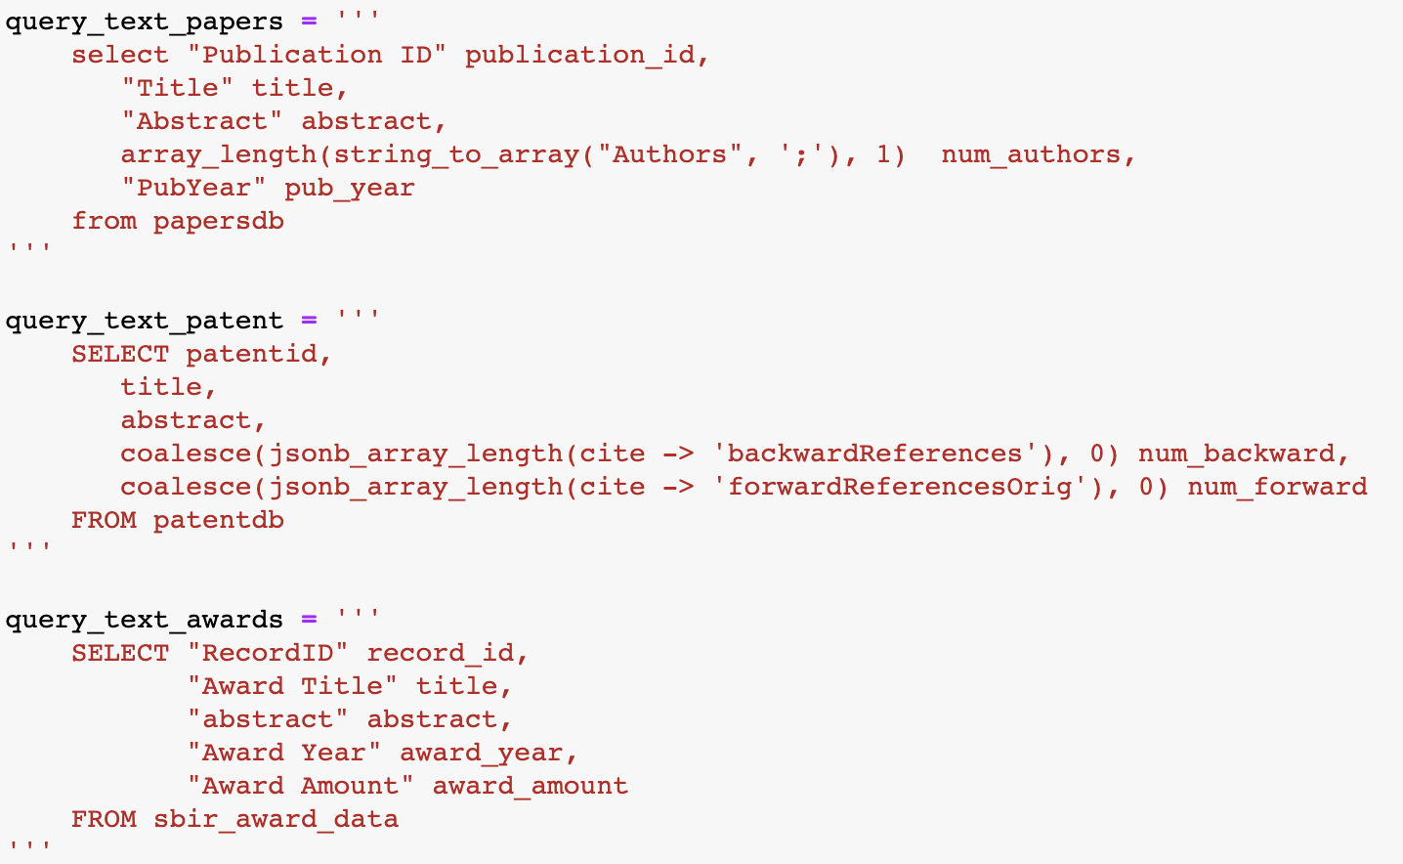
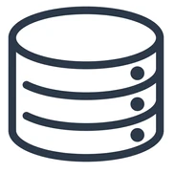
Matching keywords in datasets
Look for the existence of any keywords in the texts of the patents, awards, and papers datasets and add the found keywords as a new columns
Code to retrieve all data to python
Patents
Awards
Papers
Keyword Universe

Slide 10
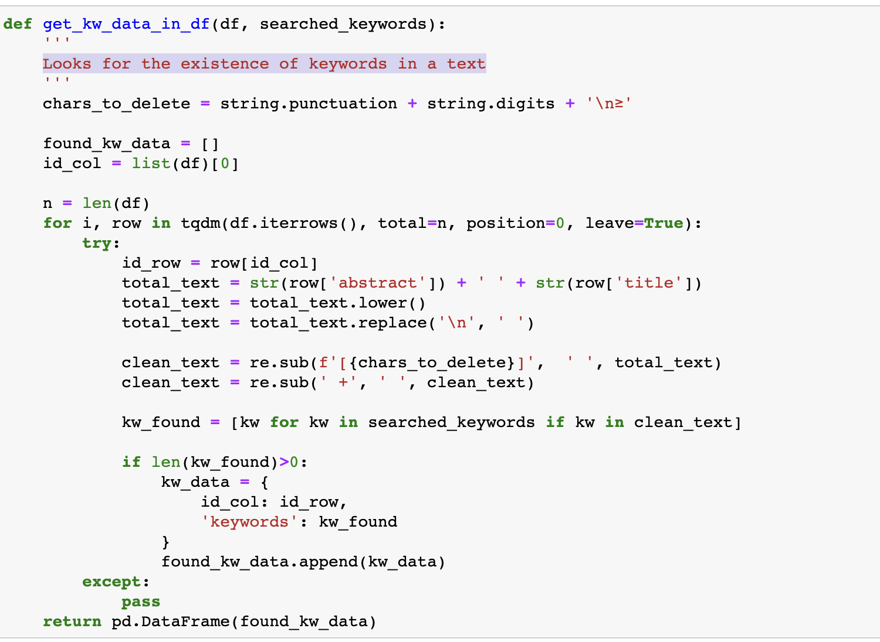
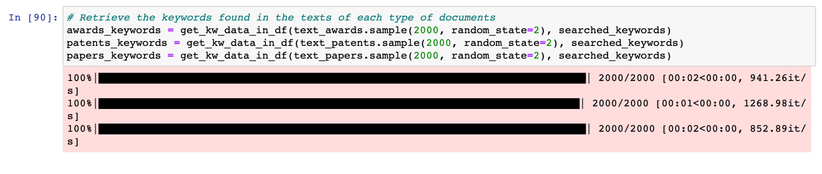
Detect keyword in from texts of
relational datasets
Now, we find whether the keyword exists in the text.
For each row, we get the title and abstract. We cleaned the text and then looked for keywords. If we find a match, we return them.
The run time was good for this since we limited the length of the abstract in the cleaning process to 3,000 words max.

Slide 11
Detect keyword in from texts of relational datasets
Our first approach was to do the previous operations in postgres but then we had issues with data cleaning so we did this in python instead.
The main challenge we faced doing it like below was that the dataset (abstract) was too big.
Original postgres query
select *
from (select b.abstract, b.patentid, array_agg(b.keywords) as keywords
from (select *,
case
when position(a.keywords in a.abstract) > 0 then 1
else 0 end tag
from (select patentid, abstract, unnest(array ['NLP', 'text classification']) as keywords
from patentdb) a) b
where b.tag = 1
group by b.abstract, b.patentid) d
join
patentdb e
on d.patentid = e.patentid

Slide 12
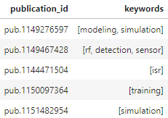
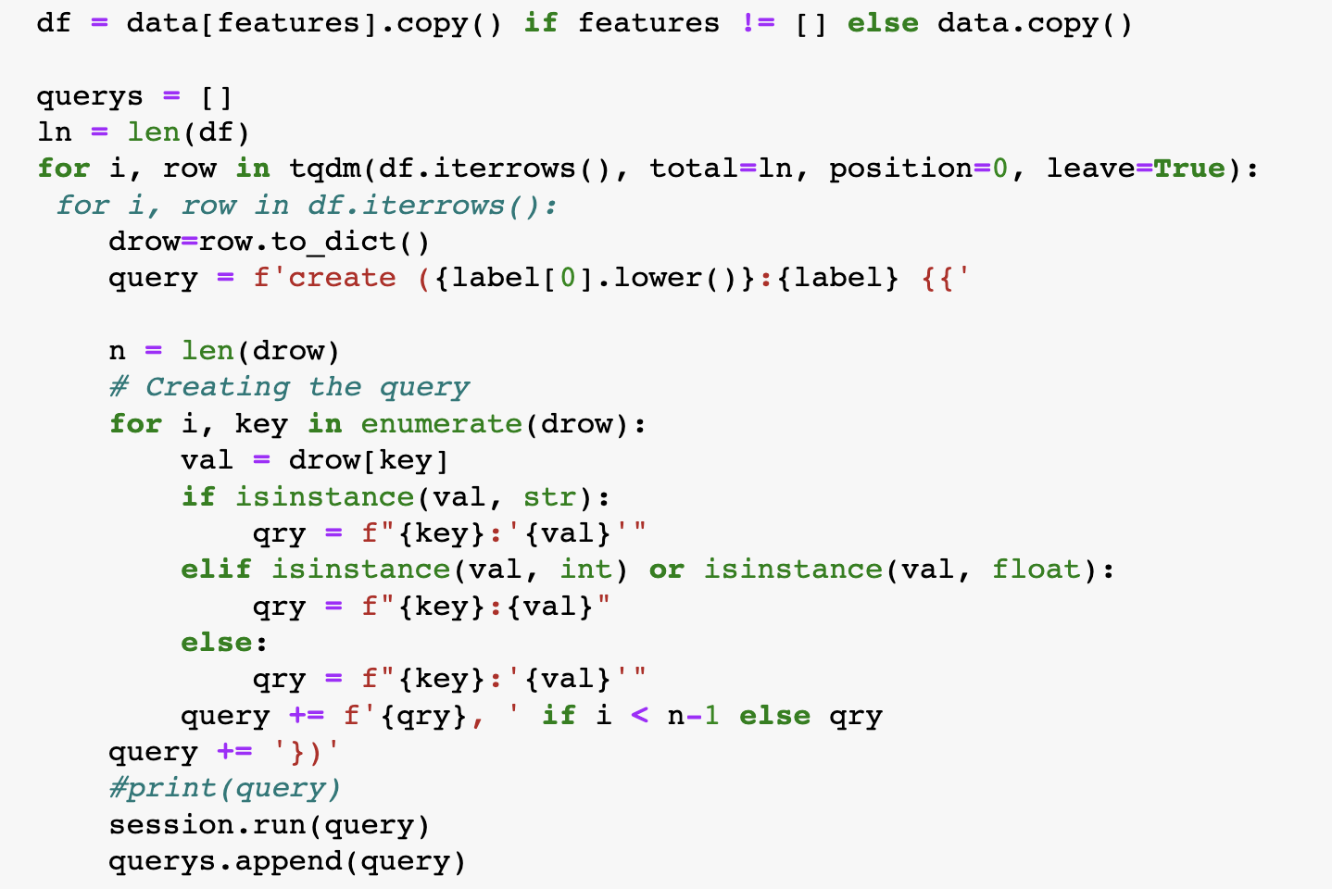
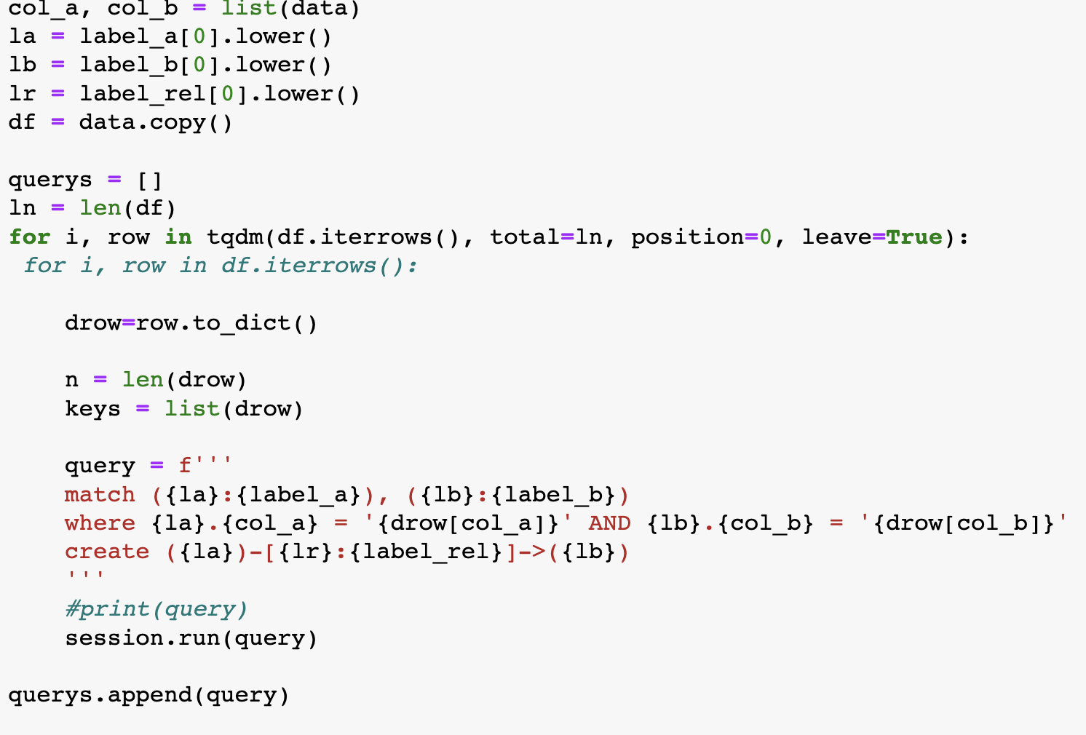
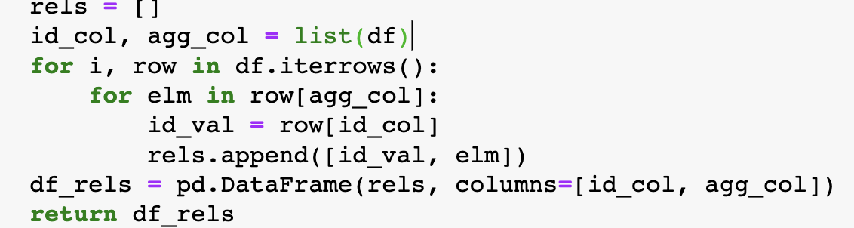
Upload the edges & relationships
Uploads the elements of a DataFrame as nodes. It will upload all the content as attributes if not specified.
Uploads the relationship between elements as edges.
Creates a dataframe unnesting a column of type str[ ]

Slide 13
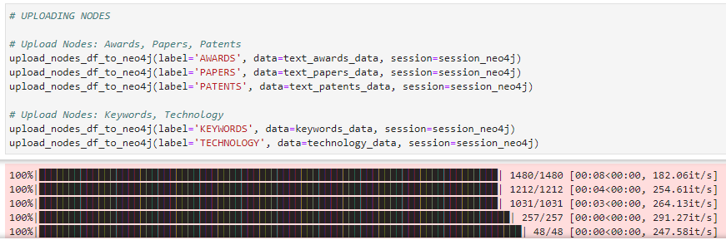
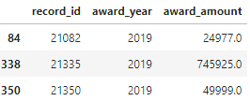
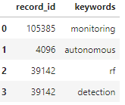
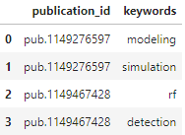
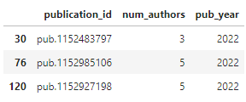
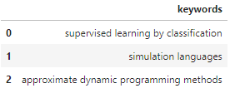
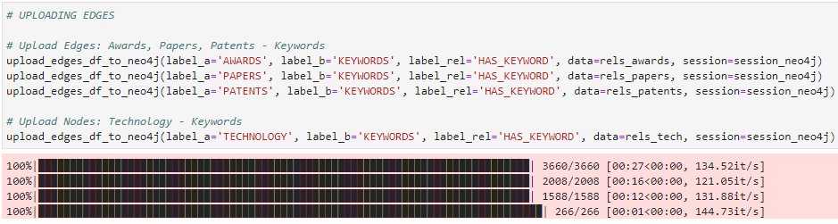
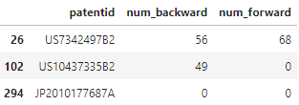
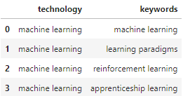
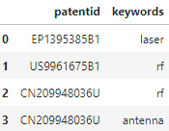
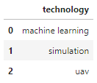
Upload the edges & relationships
4. Load the ids, keywords and attributes to neo4j
Extract the ids, keywords and attributes from postgres and load them to neo4j (nodes and edges)
Patentsdb → [‘explainability’, ‘quant computing]
Awardsdb → [‘nlp’, efficient computing‘]
Papersdb → [‘computer vision’, ‘nlp’’]
Co-occurrence graph connected by keywords
Tec1
Tec2
Tec3
Kw1
Kw2
Kw3
awards
papers
patents

Slide 14
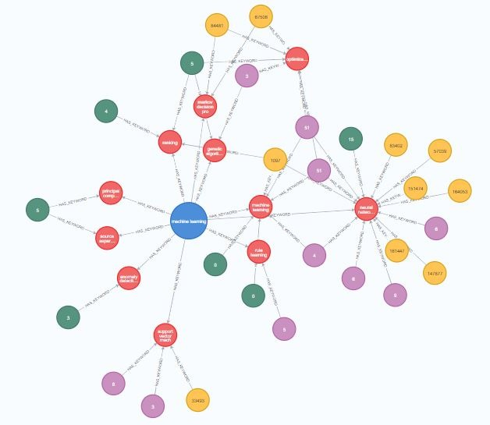
Output Neo4j network
5. Find the paths that relate the keywords from the tech to the documents
Using the keywords as intermediate nodes, find which docs are connected and return the most important
Tec1
Highest awards
Highest co-authorings
Kw1
Highest citations
Once we upload nodes and relationships into neo4j, we can query for everything related to one technology.
Tech 1 → patent_id1, patent_id2, paper_id1, paper_id2, award_id1, award_id2
MATCH (a:PAPERS)-[h:HAS_KEYWORD]->(k:KEYWORDS)<-[m:HAS_KEYWORD]-(t:TECHNOLOGY)
WHERE t.technology='machine learning'
WITH a, h, k, m, t ORDER BY a.num_backward DESC, a.num_forward DESC
RETURN a, h, k, m, t
LIMIT 10
UNION ALL
MATCH (a:AWARDS)-[h:HAS_KEYWORD]->(k:KEYWORDS)<-[m:HAS_KEYWORD]-(t:TECHNOLOGY)
WHERE t.technology='machine learning'
WITH a, h, k, m, t ORDER BY a.num_backward DESC, a.num_forward DESC
RETURN a, h, k, m, t
LIMIT 10
UNION ALL
MATCH (a:PATENTS)-[h:HAS_KEYWORD]->(k:KEYWORDS)<-[m:HAS_KEYWORD]-(t:TECHNOLOGY)
WHERE t.technology='machine learning'
WITH a, h, k, m, t ORDER BY a.num_backward DESC, a.num_forward DESC
RETURN a, h, k, m, t
LIMIT 10
Query looks for 10 papers, awards, patents based on highest $award, #co-authorings, and #citations
Network for ‘Machine Learning’ technology

Slide 15
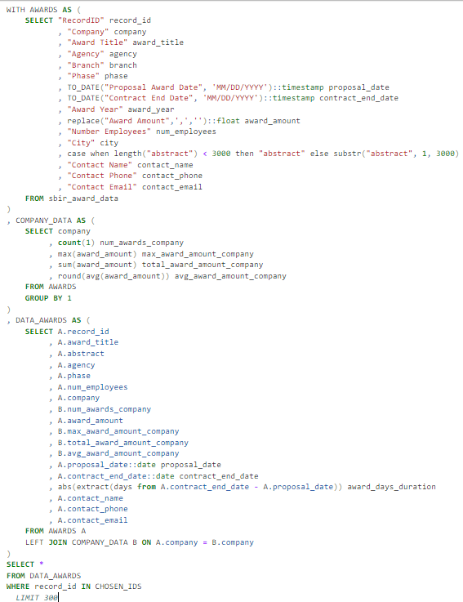
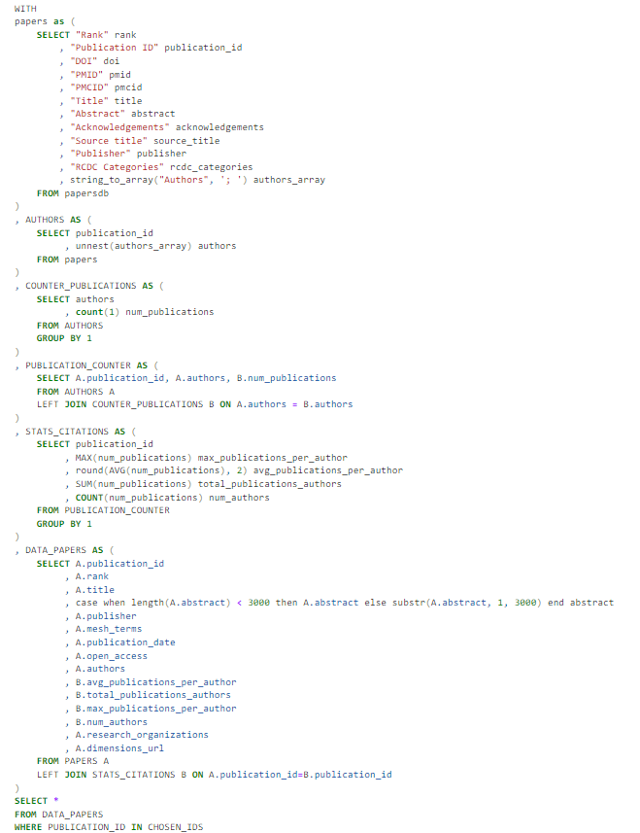
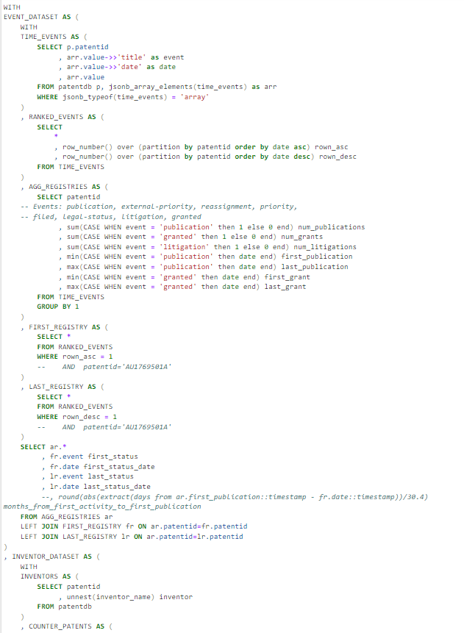
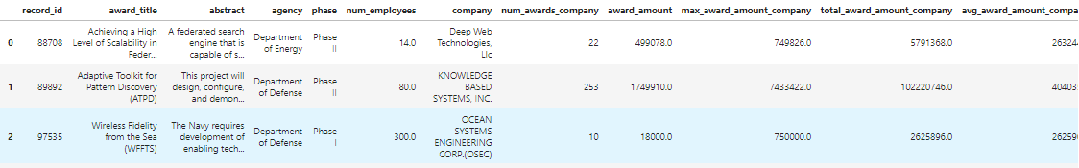
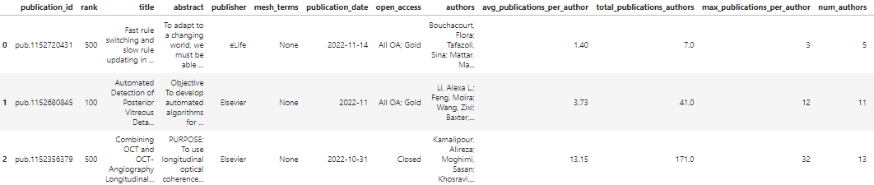
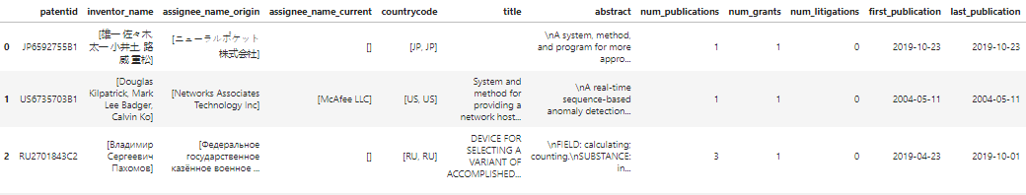
Postgres Data Gathering
6. Get information about the selected document ids
From the chosen ids, get interesting data from the available datasets on postgres.
Select
(important_data)
From patentsdb
Where id in (patent_id1, patent_id2)
Select
(important_data)
From awardsdb
Where id in (award_id1, award_id2)
Select (important_data)
From papersdb
Where id in (paper_id1. paper_id2)
We will retrieve information from postgres for the key ids obtained from the keyword co-occurrence graph.
Operations used: window functions, subqueries, groups, unnest, dates, jsonb, order,
PATENTS
AWARDS
PAPERS
PATENTS
AWARDS
Select
(important_data)
From patentsdb
Where id in (patent_id1, patent_id2)
Select
(important_data)
From awardsdb
Where id in (award_id1, award_id2)
Select (important_data)
From papersdb
Where id in (paper_id1. paper_id2)
PAPERS

Slide 16
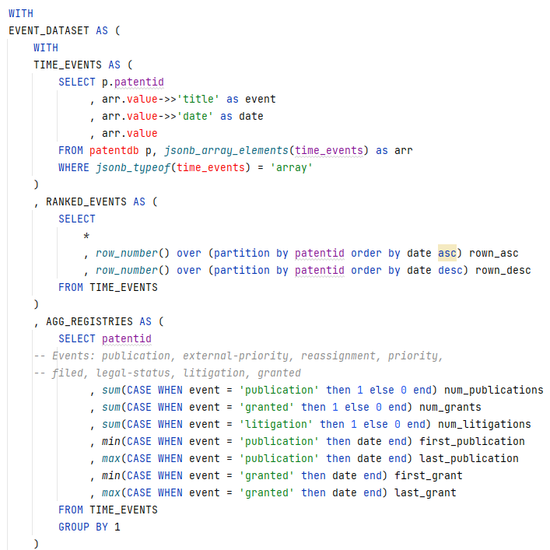
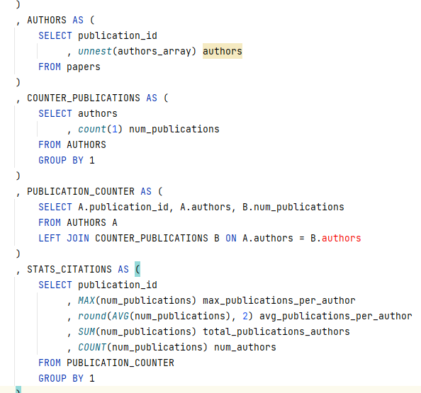
Postgres Data Gathering
6. Get information about the selected document ids
From the chosen ids, get interesting data from the available datasets on postgres.
Select
(important_data)
From patentsdb
Where id in (patent_id1, patent_id2)
Select
(important_data)
From awardsdb
Where id in (award_id1, award_id2)
Select (important_data)
From papersdb
Where id in (paper_id1. paper_id2)
The following are some of the operations we used to process the data
window functions, subqueries, groups, unnest, dates, jsonb, order,
Unnest
JSONB
Group by
Window functions
Merge
Group by

Slide 17
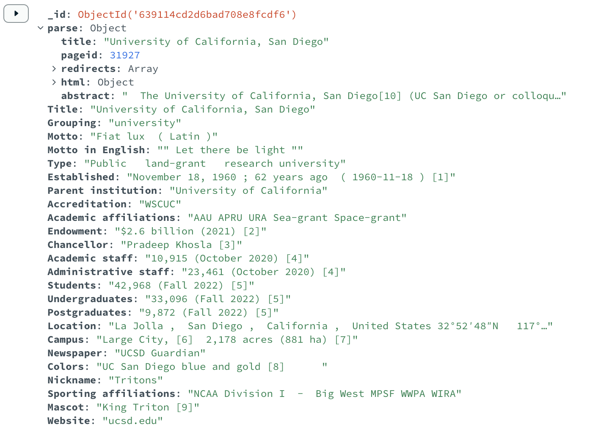
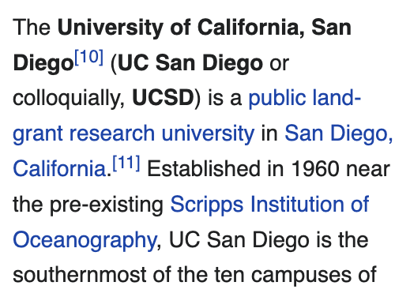
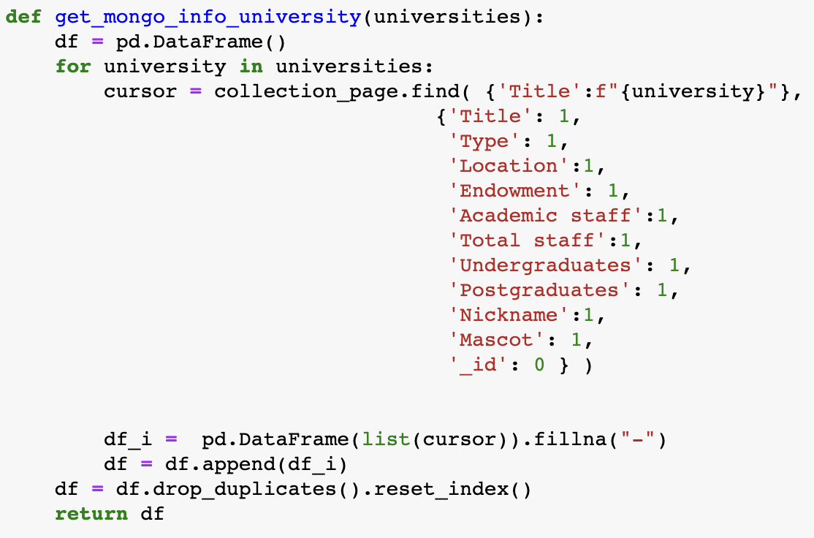

Retrieve info from Wikipedia and upload to MongoDB
7. Get wikipedia documents from the selected ids
Look for summary or sidebar information about the companies, keywords, authors, universities, etc. (technologies list)
patent_id1 → ‘General motors’ (webpage)
Paper_id2 → ‘UC San Diego’ (webpage)
Companies
Universities
Topics
Mongo DB records created for [companies, universities, other]
Using the API, we can retrieve the boxed data with the page’s html
MongoDB function to retrieve items from the Collection
Next, using Beautiful soup, we can parse the html data to extract (1) the abstract paragraphs, and (2) the infobox from the wikipedia page.
The MongoDB collection can be queried to pull out key information e.g. $Endowment, #Academic staff etc.

Slide 18
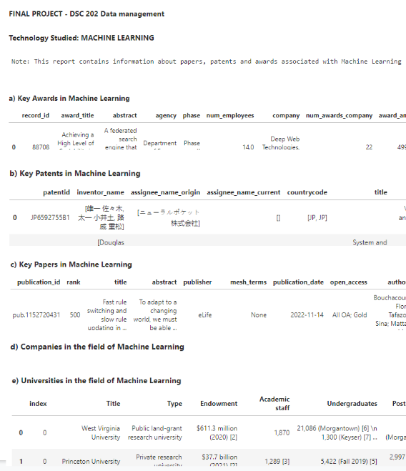
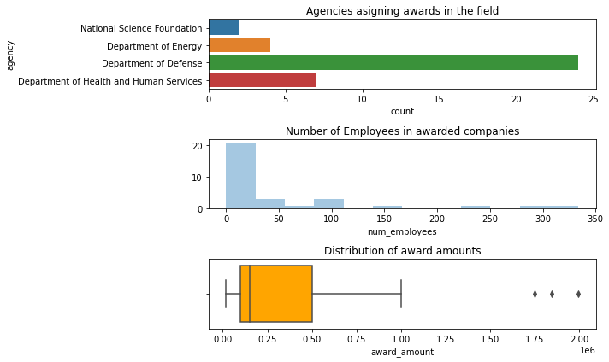
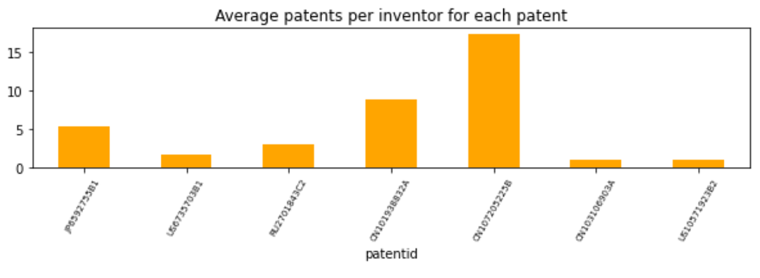
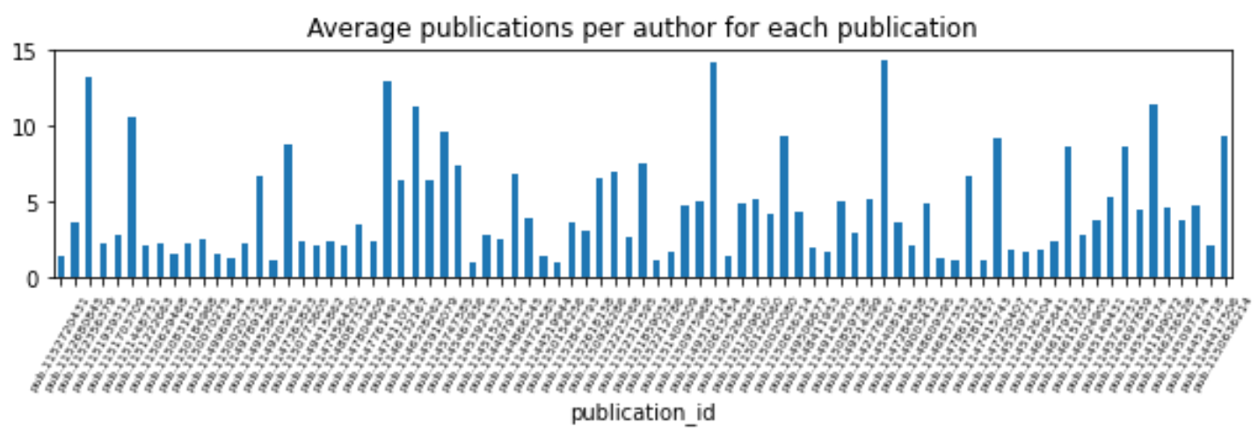
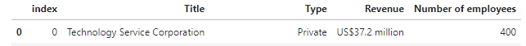
Reporting
8. Build a report with the gathered data providing recommendations
Use information retrieved from 6 and 7 to build a report for a client on who to hire, which competitors we have, among others
Topic data
Money in the game
Competitors
Tec1
Legal implications
Hiring prospects
Overall evaluation
Now we are able to create a report for each one of the technologies once we select them

Slide 19

Next Steps
Expand keyword universe list by incorporating new sources besides the ACM ontology. Using the ACM website only picked up computing related technologies
We could look for approximate matches when keyword matching e.g. ‘machine learning’ vs. ‘learning machines’. (‘fuzzy wuzzy’ library)
We only uploaded ~2000 nodes (papers, patents, awards) of each, we could try to do this for all the data and get a denser data.
Wikipedia information retrieved through the API needs significant cleaning for the data to be more operable. Ideally this should be done before the upload. If this was the case, we could do more complex queries through the mongo connection rather than in python with the retrieved data.
Parallelize the code to use multiple cores on our machines or upload all data to the cloud to take advantage of elastic resource capability.

Slide 20
Happy Holidays!

